Slide 1

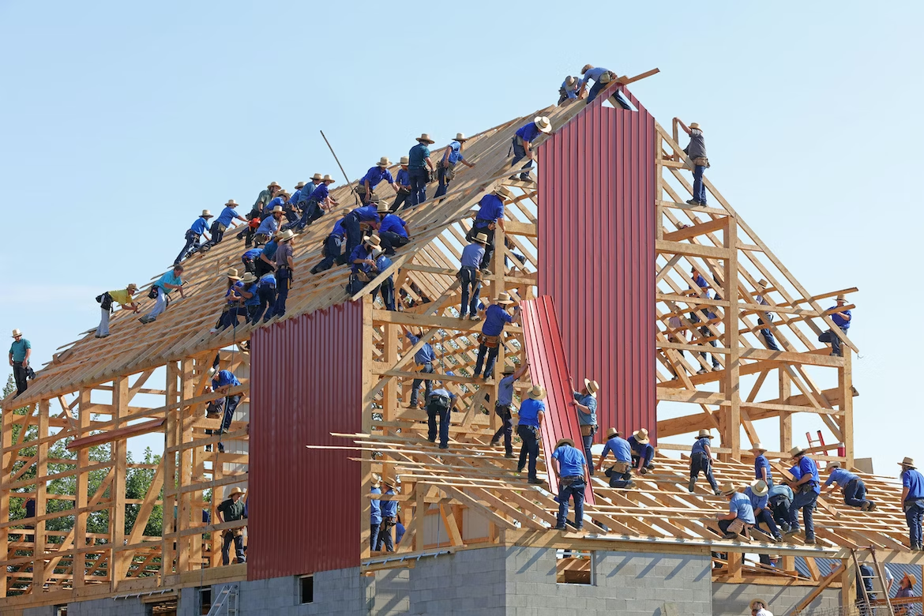
Massive Cooperation in ISPOs and OSPOs

Slide 2

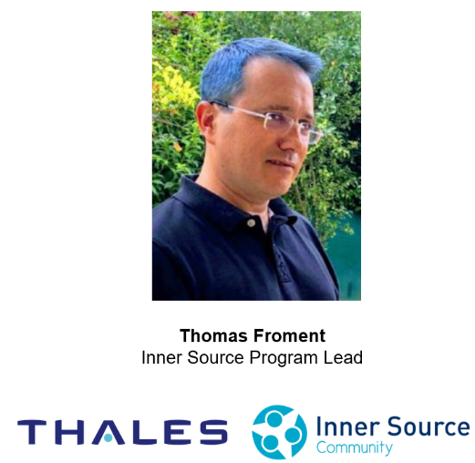
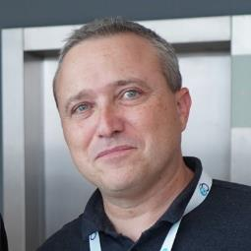


Past
TODAY
Co-Founder CTO

Slide 3
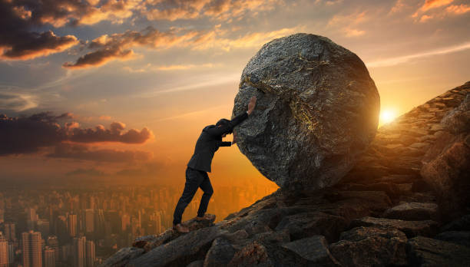
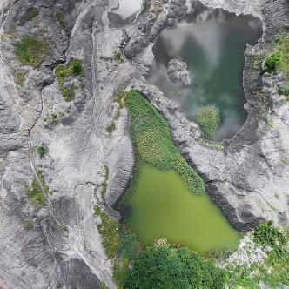

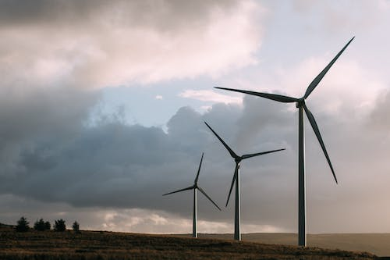
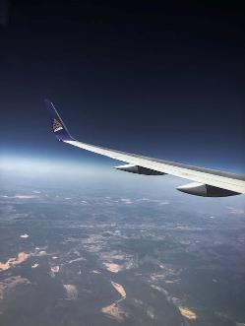
WHY ?
Notes:
🌱We recognize that ecological, social, and human challenges are enormous.
we believe it's time to tackle the world's biggest challenges head-on.

Slide 4


WHY ?
Notes:
✨We draw inspiration from the vast array of resources available on the internet and social media but now... ⚡We believe that inspiration must turn into action.

Slide 5
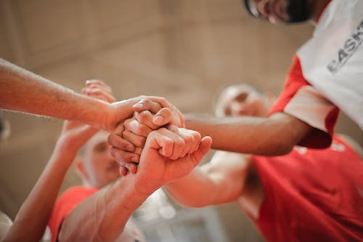
WHY ?
Notes:
🤼‍♂️To take on these big problems, we believe that massive cooperation is probably the only way forward.

Slide 6

WHY ?
The Massive Cooperation Framework (MCF)
Notes:
🤝We don’t want to work in isolation; we want to empower everyone to take action together. 🔓That's why we're committed to developing massive cooperation in open source, making it adaptable and contributive to all.

Slide 7

GREAT GOAL
An ecosystem of + 50 companies, schools and foundations, involving 1000 contributors to the Massive Cooperation Framework by 2030

Slide 8
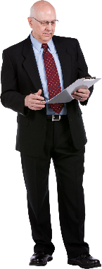




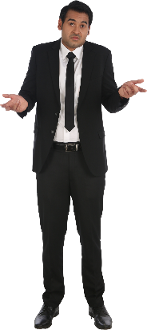
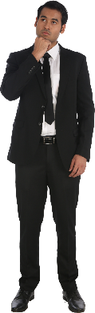
MCF from the field EXAMPLE 1
Members
Company (Institution)
Come join my community, it's really awesome!
Alissa
But my Company don’t catch all the potential!
Karl
But my members don’t come!
Enzo
Program Community Lead

Slide 9
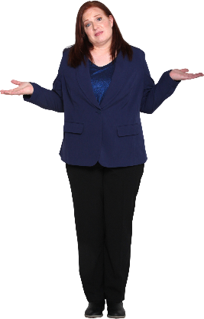

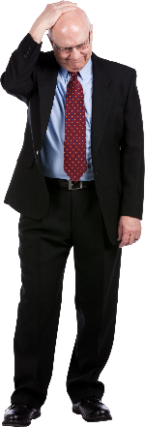




MCF from the field EXAMPLE 1 Reading GRID
Members
Company (Institution)
Institutional commitment
Working time
Institutional resources (premises, tools, materials, budgets, etc.)
Skills and network
Personal commitment
Personal time
Personal resources
Skills and network
1
2
Alissa
Karl
Enzo

Slide 10
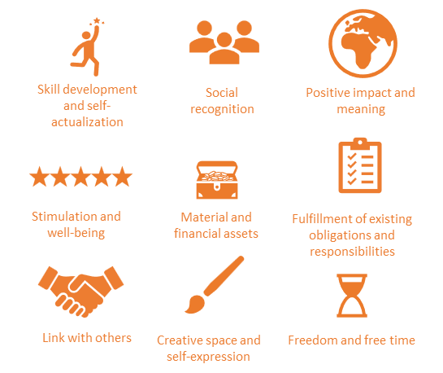

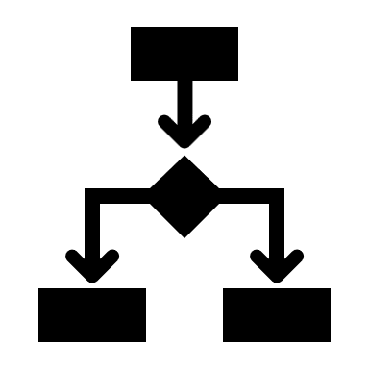

MCF from the field EXAMPLE 1 Reading GRID
Members
Company (Institution)
Institutional commitment
Working time
Institutional resources (premises, tools, materials, budgets, etc.)
Skills and network
Personal commitment
Personal time
Personal resources
Skills and network
1
2
Value for members
3
4
Value for the company
Human resources improvements
Operational improvements and serving the company's purpose
Business improvements

Slide 11
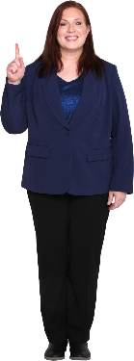
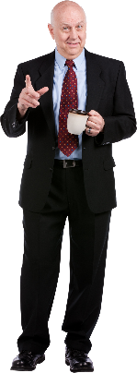
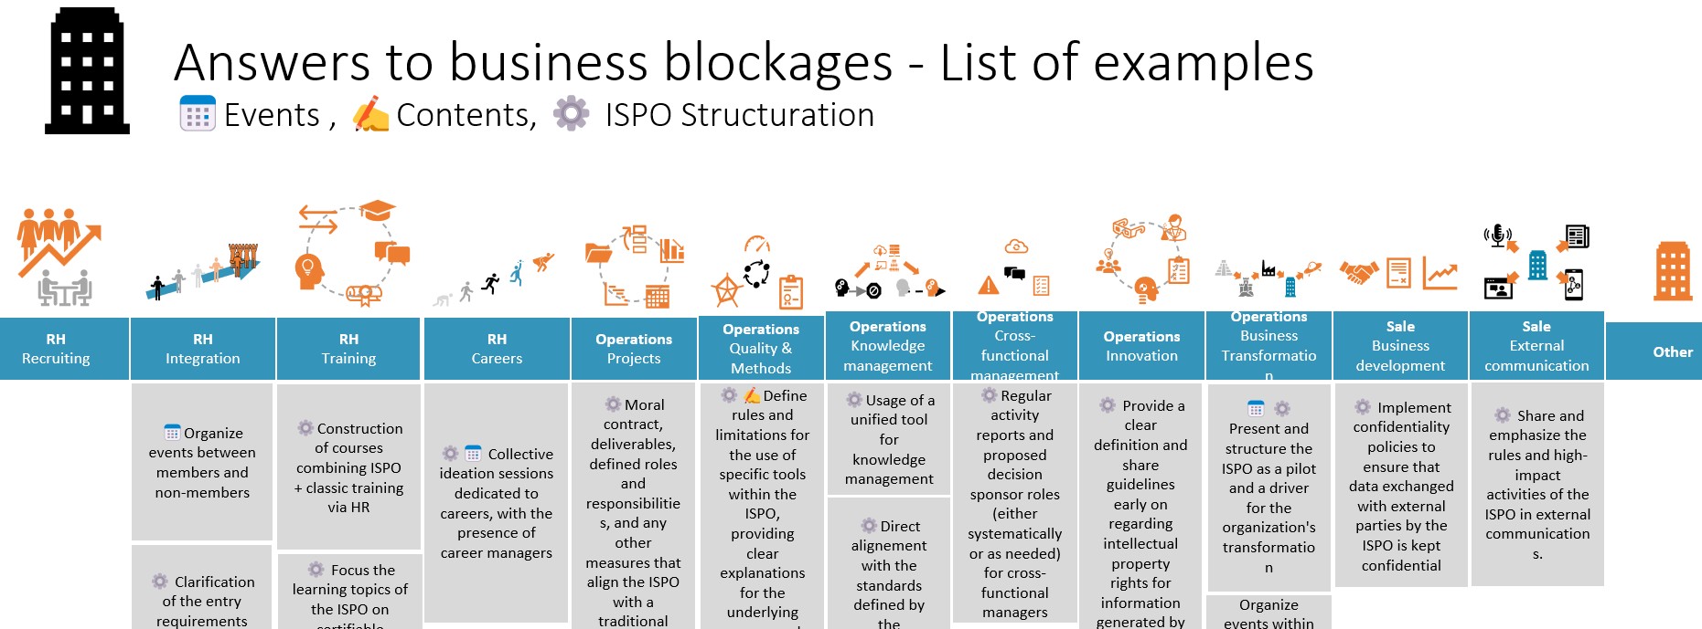
MCF from the field EXAMPLE 1 In the FRAMEWORK
Members
Company (Institution)
1
2
3
4
Alissa
Karl

Slide 12
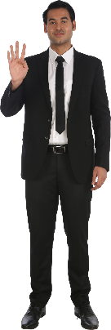
MCF from the field EXAMPLE 1 MORAL OF THE STORY
Alissa
Enzo
Karl
The value for you may not be the same as for others
Take time to analyze the four arrows: provided value, requested value, for the members and for your company

Slide 13
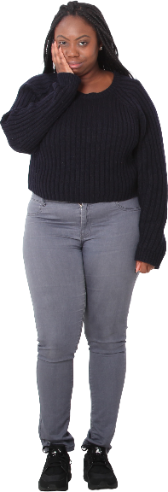
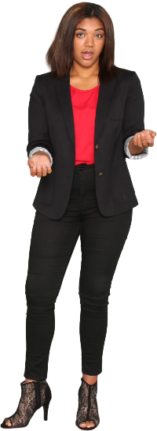
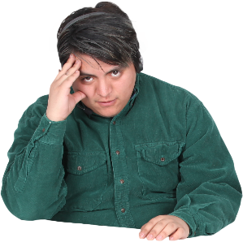
MCF from the field EXAMPLE 2
Why you don’t organize more events, I am starting to get bored
You are asking too much, I am tired
Bob (community member)
Carol
Program Community Lead
Alice
(Community member)

Slide 14
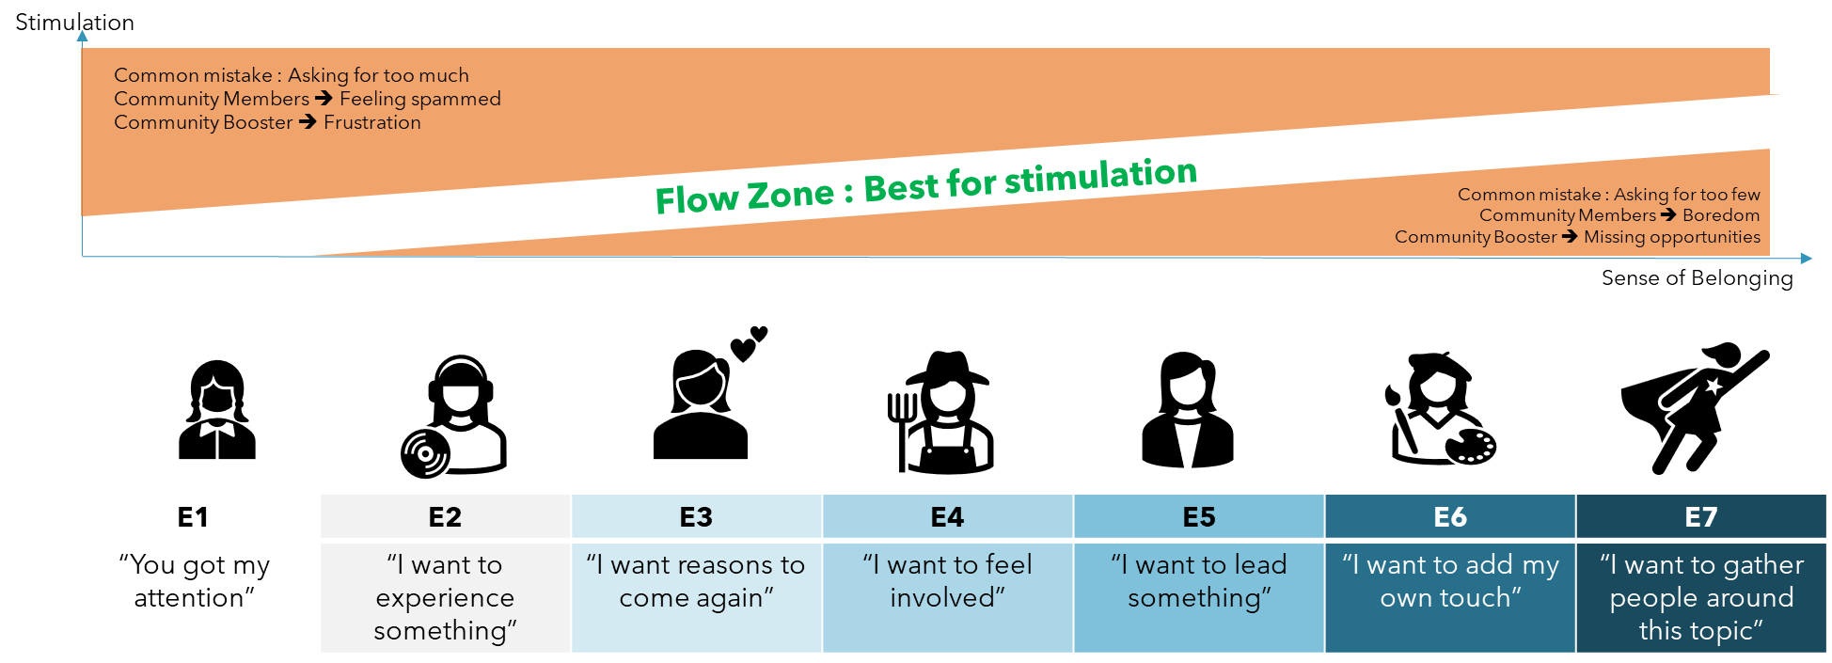
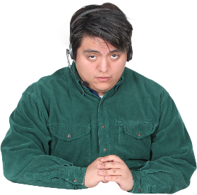
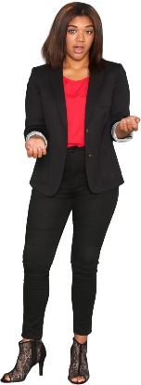

MCF from the field EXAMPLE 2 READING GRID
Bob
Alice
Carol

Slide 15
MCF from the field EXAMPLE 2 In the framework

Slide 16
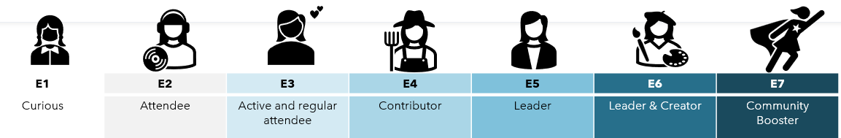
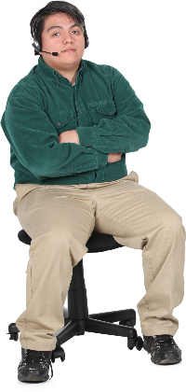


MCF from the field EXAMPLE 2 MORAL of the STORY
Bob
Alice
Carol
Do not assume that all members of a community can have the same level of engagement.
Adapt what is being offered to the engagement level of the members.

Slide 17
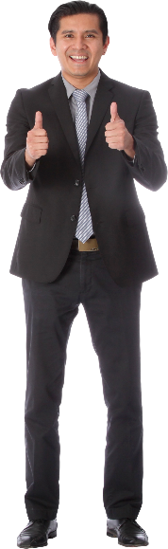
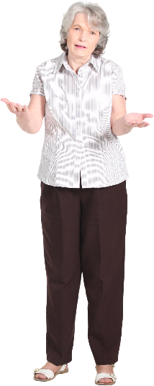
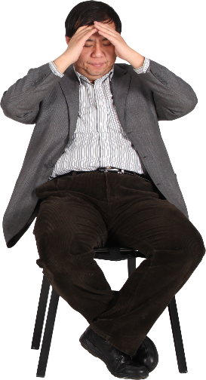
MCF from the field EXAMPLE 3
We have been working on standardizing the practice for two years
Hey, come listen to this super inspiring talk!
I don’t need inspiration, I need concrete solutions
Mike
Member
Luis
Program Community Lead
Jane
Member

Slide 18







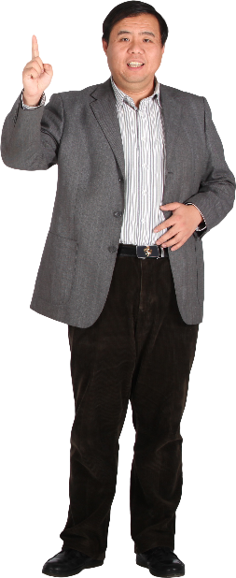
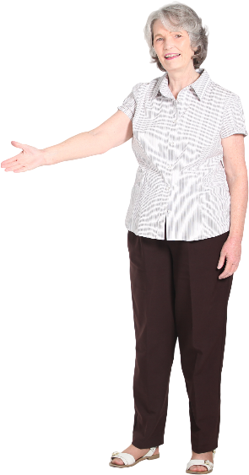
MCF from the field EXAMPLE 3 READING GRID
Change Community Cycle
7 phases of community life that bring change
INSPIRATION
COLLECT
INITIATION
SHOCK OF REALITY
CONFIRMATION OF SUCCESSES
EXHIBITION
FORTIFICATION
Indeed, all of this is not automatic or intuitive for everyone. Having a pathway or guidance helps
The role of the community can go beyond mere inspiration. It can support its members throughout the implementation of a change, leading up to new standards
Luis
Mike
Jane

Slide 19
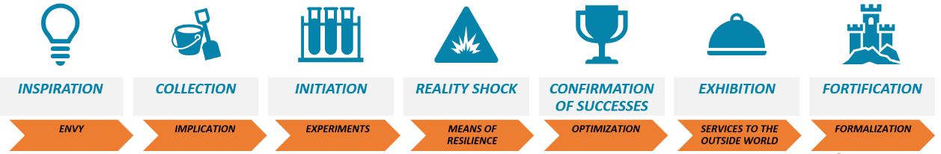
MCF from the field EXAMPLE 3 In the framework
Change Community Cycle

Slide 20
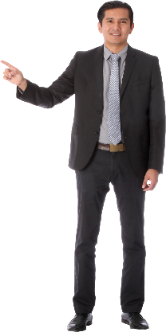
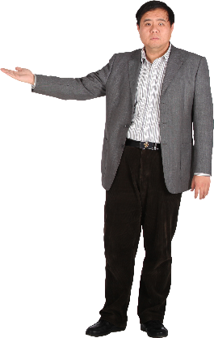
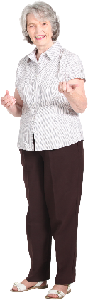
MCF from the field EXAMPLE 3 MORAL OF THE STORY
Change Community Cycle
INSPIRATION
COLLECT
INITIATION
SHOCK OF REALITY
CONFIRMATION OF SUCCESSES
EXHIBITION
FORTIFICATION
Do not underestimate the frustrations associated with poor timing in community / collaborative program lifecycle
“Precision beats power, timing beats speed” (Credits to Conor McGregor)

Slide 21
Massive Cooperation Framework
Much more than
what you saw today

Slide 22
Massive Cooperation Framework
Much more than
what you saw today

Slide 23
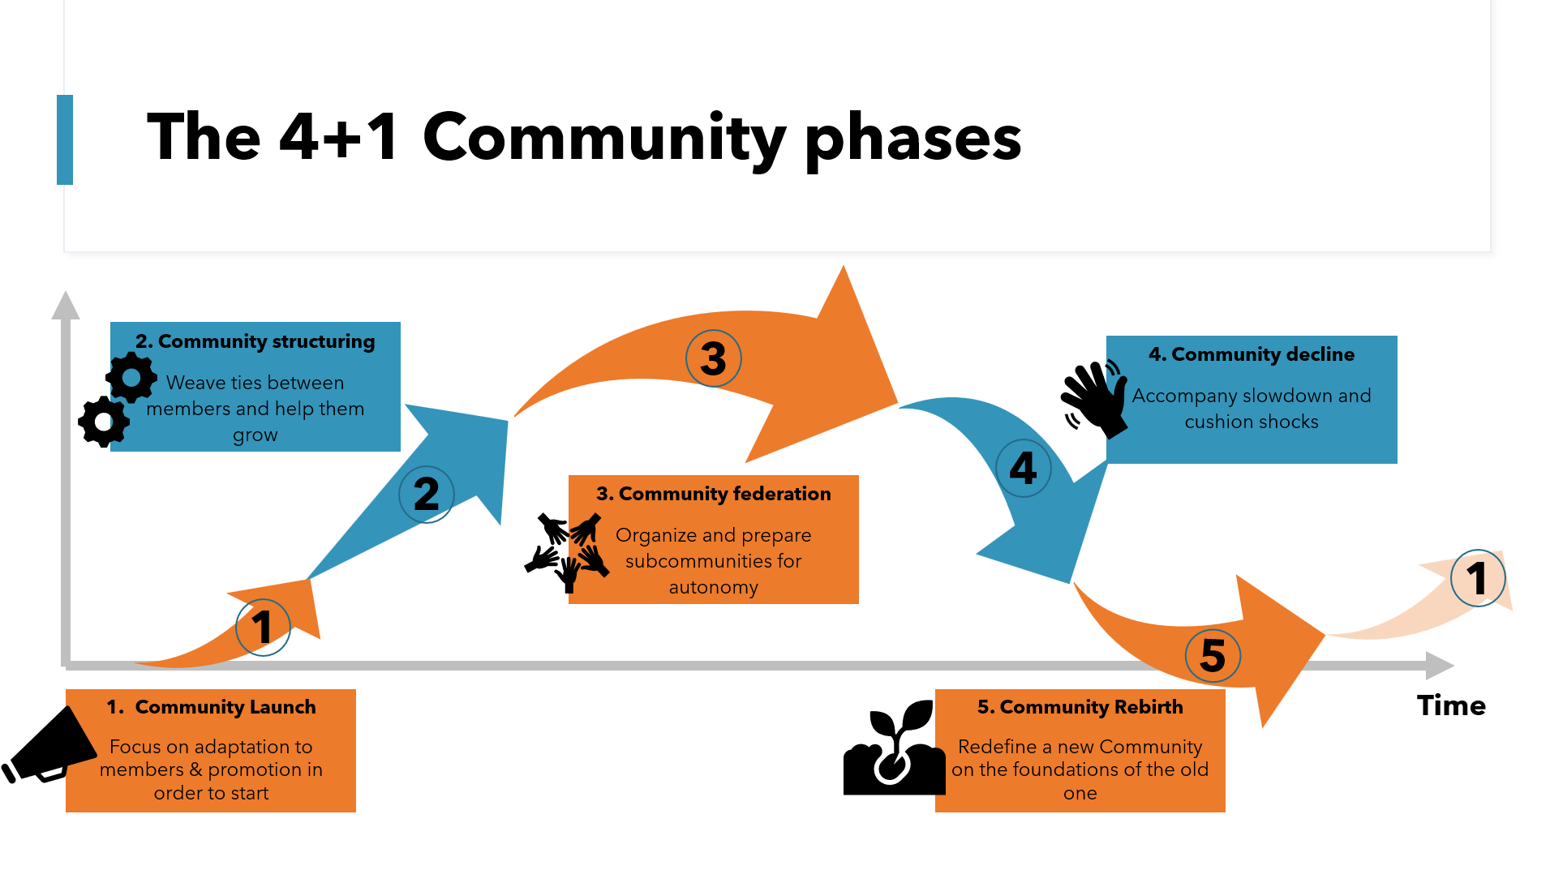
Massive Cooperation Framework
Much more than
what you saw today

Slide 24
Massive Cooperation Framework
Much more than
what you saw today

Slide 25
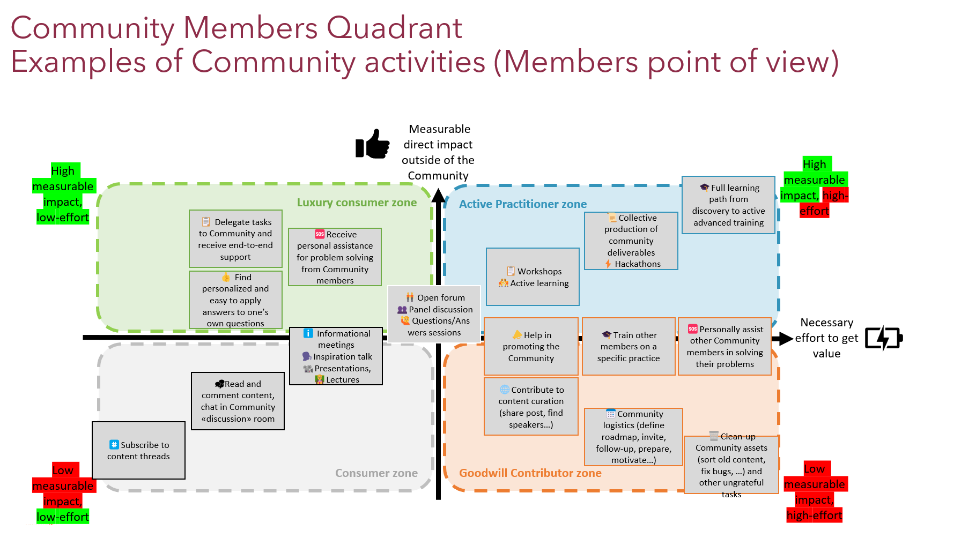
Massive Cooperation Framework
Much more than
what you saw today

Slide 26
Massive Cooperation Framework
Much more than
what you saw today

Slide 27
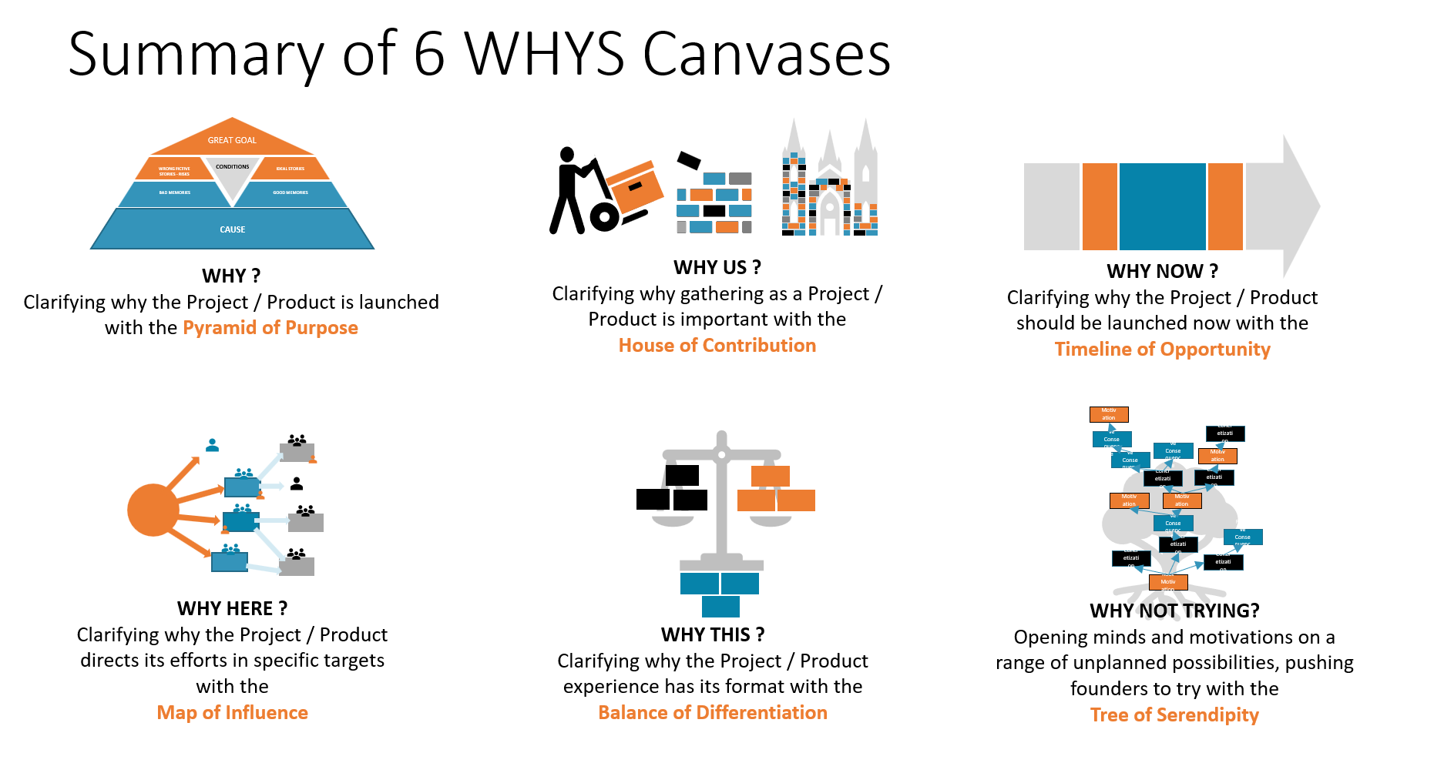
Massive Cooperation Framework
Much more than
what you saw today

Slide 28
Massive Cooperation Framework
Much more than
what you saw today

Slide 29
Massive Cooperation Framework
Much more than
what you saw today

Slide 30
Massive Cooperation Framework
Much more than
what you saw today

Slide 31
Massive Cooperation Framework
Much more than
what you saw today

Slide 32
Massive Cooperation Framework
Much more than
what you saw today

Slide 33
Massive Cooperation Framework
Much more than
what you saw today

Slide 34
Massive Cooperation Framework
Much more than
what you saw today

Slide 35
Massive Cooperation Framework
Much more than
what you saw today

Slide 36
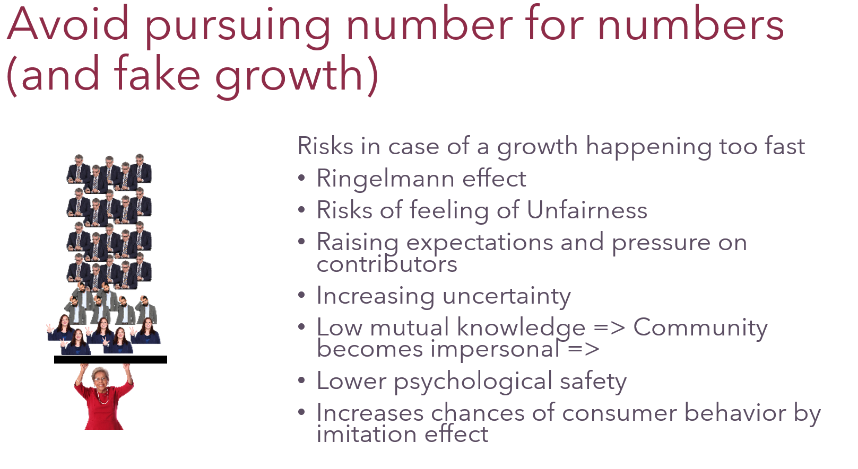
Massive Cooperation Framework
Much more than
what you saw today

Slide 37
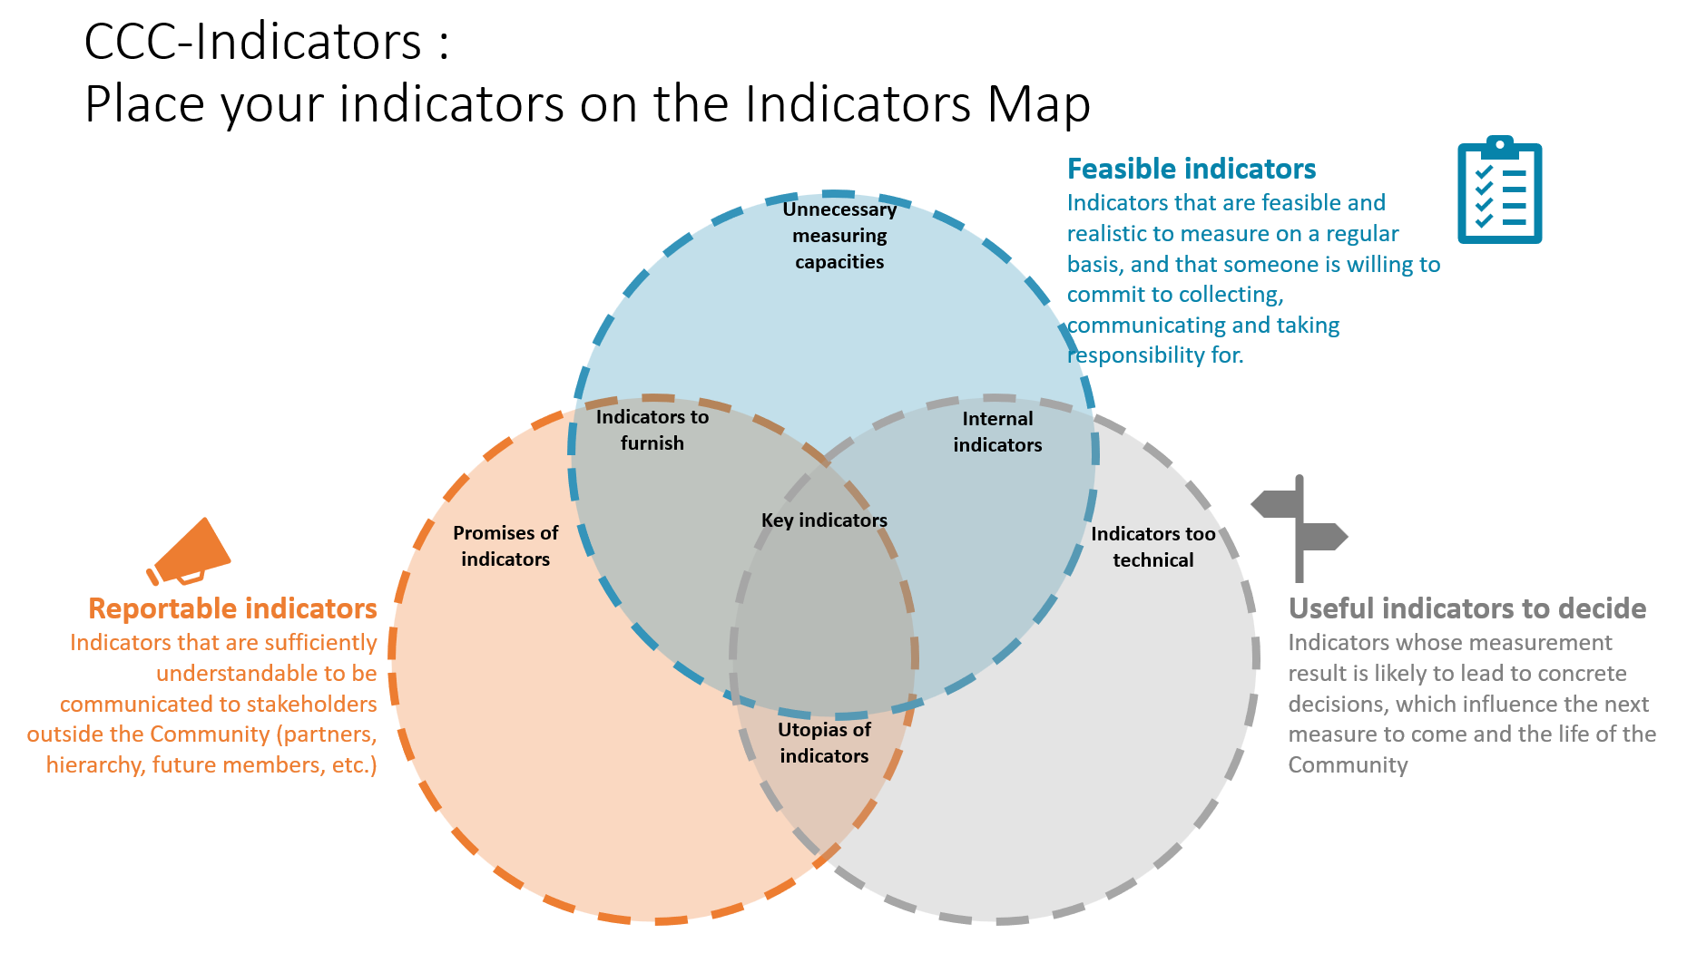
Massive Cooperation Framework
Much more than
what you saw today

Slide 38

In SHort

Slide 39

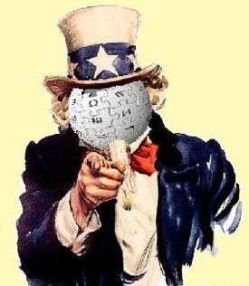
And you?
Questions

Slide 40


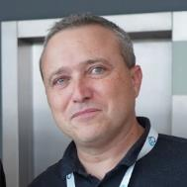
Find out more about Komyu on
News: https://www.linkedin.com/company/komyucorp/
Web site: www.komyu.io
Partial (and mainly FR) content of MCF: https://openseriousgames.org/openseriouscommunity/
Coming soon –
Full Open Source framework: https://github.com/massivecooperation
corporatecommunities.org
innersource.fr
thomas.froment@komyu.fr
https://www.linkedin.com/in/tfroment/

